Slide 1

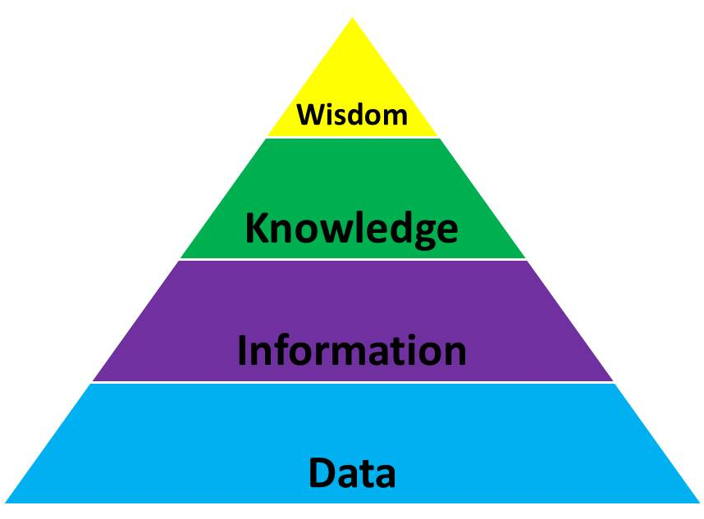



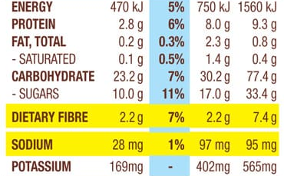
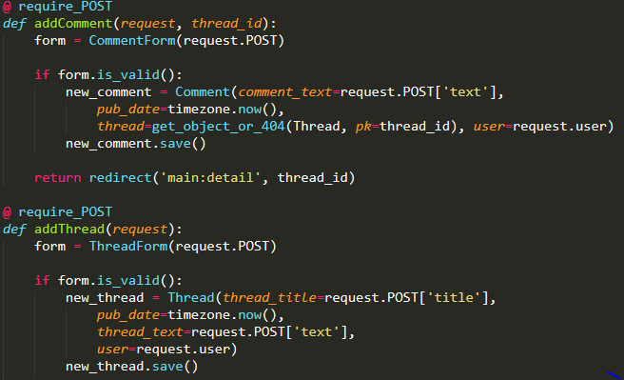


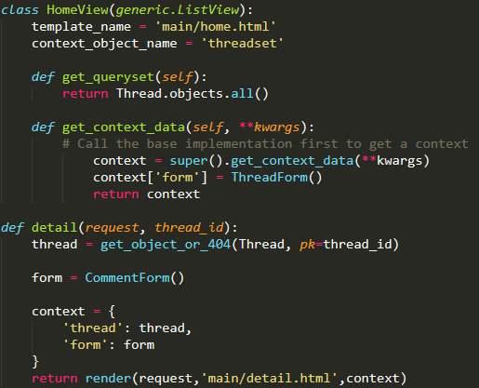





Database Systems
The external view can be interpreted as being the front-end of the data, what the clients show and what the users perceive. It is how the data is submitted and styled with stylesheets and other front-end languages such as HTML and JavaScript. The below screenshot is an example of viewing data externally, with the various products in the JB HI-FI site displaying their PC’s, each PC is formatted within a table with a name and a price with additional information being it’s manufacturing, rating (out of five starts) and a brief description of the specifications of the machine
Within working with data, a common way to approach viewing data is to view data within three layers. These three layers demonstrate three different ways data can be viewed being an external view, a logical view and an internal view. The external view being the front-end and user view on the data. The logical view being how a web app developer or full stack develop would use and convey data within a system (in the case of a web app developer the system being a web app; with sub-systems of forums and user models, login etc. The internal view is the physical storage of the data and is usually only seen by data administrators and data management services.
Data-driven solutions are digital solutions that are made for the purpose of distribution and extortion of data. There are many instances of raw data within the world around us and data-driven solutions have to be created for viewing and use of this raw data., The power of data is not merely the viewing of raw data, but instead the implications and extrapolations that can be created from this data. The Data Pyramid demonstrates how this data gains meaning and how data can lead to information on a topic, to varying levels of knowledge to an in-depth wisdom upon a given topic.
The logical view is how the data is structured, maintained and accessed. This refers to how data-driven solutions are created by developers with the characteristics and meaning of data. The system of data and how all data relates to each other is within the logical views. Through visual elements such as tables, data flow diagrams (DFD) and entity-relationship diagram, data can be viewed in a logical view with their significance to a solution and other data. This following example is how models can be linked with data being consistent across the models.
Visual communication of data
This is an example of the data pyramid and how statements on this product can be extracted and extrapolated from it’s nutritional information. Through the nutritional value analysis and comparison, one can have greater knowledge on the nutritional value of a given cereal and have the wisdom to pick the right cereal.
The internal layer is the physical storage and structure of the data. Whether data is stored in files, servers with management systems or hardware, internal data refers to the actual storage of data.
Data is pointless if it can not be analysed. As seen with the data pyramid; the benefits of data being information, knowledge and finally wisdom, cannot be found if the data cannot be interpreted. To interpret this data it must be presented in the correct manner. These manners can be comprised and described with elements of visual communication. In the context of the web app, this visual communication data is built within the frond-end of a solution; using stylesheets, HTML tags and front-end languages such as JavaScript.
The first element outlined in the QCAA Digital Solutions textbook is space. Space is used when displaying data in groups with sufficient distance between front-end elements, The zoning of data can be develop predictability and make the website more easily learnable and thus accessible. Spacing is good for distinguishing different groups and instances of data and thus attributes to the aesthetic quality of a webpage. With other elements such as shading and overlapping, the illusion of three dimensional aspects with the UI occurs. ‘Materialize’ a website that provides such stylesheets that can be implemented and downloaded within a digital solution. The distinctive feature of ‘Materialize’ is the shading and concept of depth within webpages and importing such third-party CSS can make developing front-end easier.
[insert register form Django example]

Slide 2

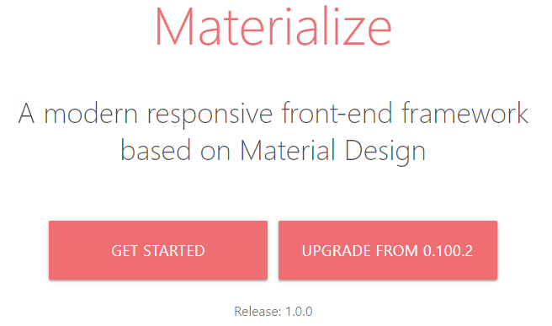


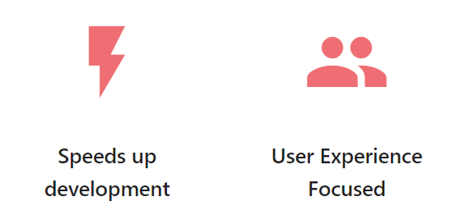

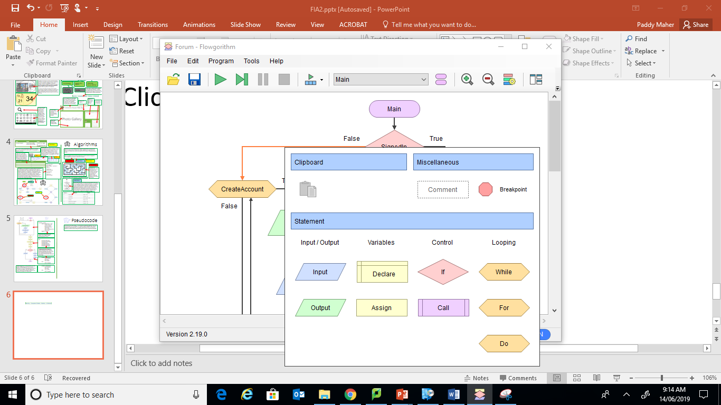

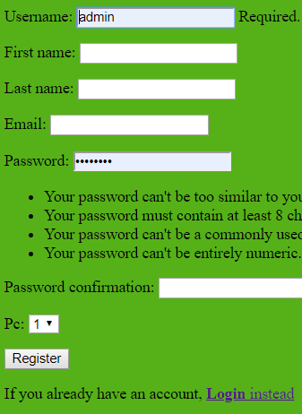
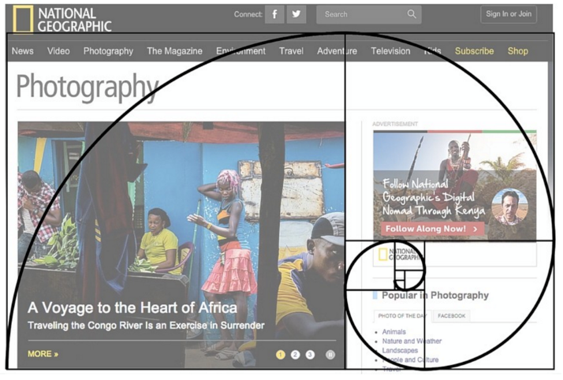
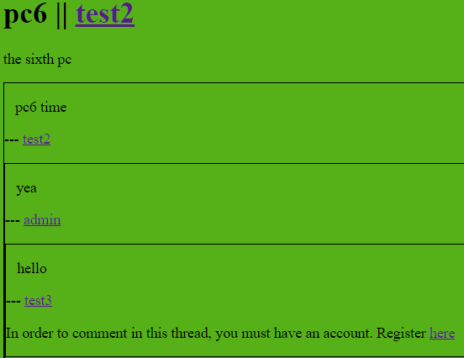


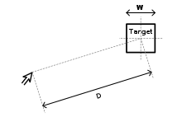
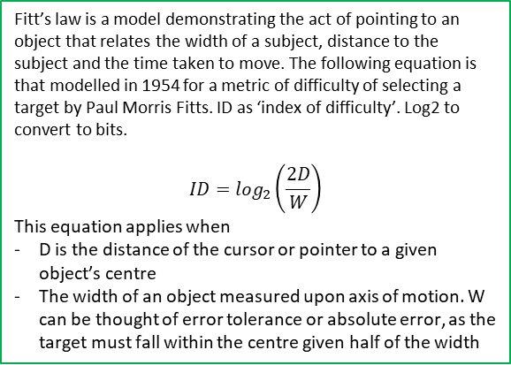
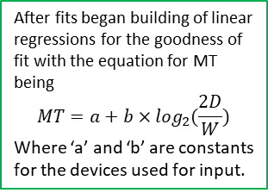
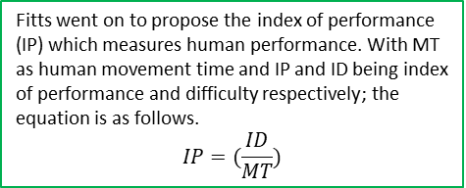
Database Systems- continued
Contrast is another principle of visual communication and is based on the rule that entities and objects are more easily seen with colours in contrast with each other
Principles of visual communication of data
‘Colour and tone’ is another element listed by and within the QCAA Digital Solutions textbook. Within developing visual elements; there must be consideration on colour and how it is used and displaying. A rule of using colours within the front-end is to keep continuity and general consistency in what colours are used within the web app. As can be seen with the Materialize web page, there is consistency in the colouring of the buttons and distinctive elements in the front-end development. The same colour is found at the top of the page with the header and is used later in the page.
Repetition also attributes to the user interface experience. Reusing elements and visual communication elements and is common within data-driven solutions such as the assessment states. Elements such as sections of products and layouts of pages can be also consistently within a webpage for users to more easily interact with data and a web app. Datasets are often set in rows and this tabulation and uniformity can be seen as repetition with displaying data
Alignment is a fundamental feature of visual communication as it determines how objects and entities are displayed. Alignment can make a large difference in how users can interact and perceive a form or web app. Elements of space, scale, proportion and proximity are all a part of further alignment. Within a form, use of these elements and alignment can impact the user experience immensely.
The classic black text on a white background is the most universal and widely used example for contrast as it the most effective and simple practice of contrast.
Implementation of clear levels of hierarchy can immensely attribute to the user-friendliness of a website in regard to navigation and the general interface. The principle is used to highlight importance of particular features and objects within a given web page. Natural tendencies of humans also need to be considered in hierarchy, as hierarchy is designed in order to position the user to look and view particular sections of content within a web page. These tendencies may include the human want to look at the top left of the screen; therefore the logo or home can easily and consistent been seen as designed by many web apps.
‘Line, shape, texture, form’ is the following sub-heading within the QCAA Digital Solutions textbook. The line element is a integral part of a web app for the alignment and hierarchy of a given web page. Shapes can be comprised from lines for two-dimensional objects. Shapes can be used to form visual data relationships such as within data-flow diagrams (DFDs) and entity-relationship diagrams. Within these representations separate shapes describe different types of ways data can be extorted and exchange, such as I/O functions and conditional statements. The array of shapes with their corresponding meanings was found within the ‘Flowgorithm’ software, where DFDs can easily be made to outline the processes in an algorithm.
‘Proportion and scale’ follows as the next element within the QCAA textbook. Within visual design, objects in a site must be spaced in a way that is aesthetically pleasing. Mathematical concepts such as the ‘golden ratio’ are ratios between objects as to how they are positioned. This can be seen on the ‘National Geographic’ website. The golden ratio and other mathematical concepts UX designers employ help make object orientation easy on the eye.
The registration form used within the web app uses these visual elements of alignment and repetition, with the objects evenly spaced in a repetitive and well spaced and scaled manner.
Balance follows on as another principle of visual communication. Balance refers to symmetry and an element of equality in how the objects and web pages are formatted. Aesthetic benefit comes from the balanced proximities and alignment within a given web page.
Fitt’s law is a model demonstrating the act of pointing to an object that relates the width of a subject, distance to the subject and the time taken to move. The following equation is that modelled in 1954 for a metric of difficulty of selecting a target by Paul Morris Fitts. ID as ‘index of difficulty’. Log2 to convert to bits.
$$ID=\log_{2}\left(\frac{2D}{W}\right)$$
This equation applies when
D is the distance of the cursor or pointer to a given object’s centre
The width of an object measured upon axis of motion. W can be thought of error tolerance or absolute error, as the target must fall within the centre given half of the width
Proximity is the final principle of visual communication and is relation the relative position of objects within a web page. Information can easily be compacted and ‘clumped’ together which can adversely impact the proximity and user visibility of objects within a web page. It depends how a designer wants a user to view their web page. A designer may want information to be view as a ‘clump’ and thus may have the effect of all information as one and related to each other or can split it up and make the information seem as if they are separate entities
After fits began building of linear regressions for the goodness of fit with the equation for MT being
$$MT=a+b×\log_{2}(\frac{2D}{W})$$
Where ‘a’ and ‘b’ are constants for the devices used for input.
Data1 | Data2 | Data3
Info1 | Info2 | Info3
Fitts went on to propose the index of performance (IP) which measures human performance. With MT as human movement time and IP and ID being index of performance and difficulty respectively; the equation is as follows.
$$IP=(\frac{ID}{MT})$$
Data1
Info1
Data2
Info2
Data3
Info3

Slide 3

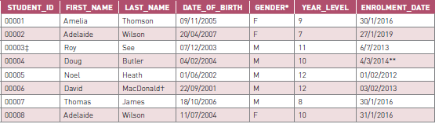
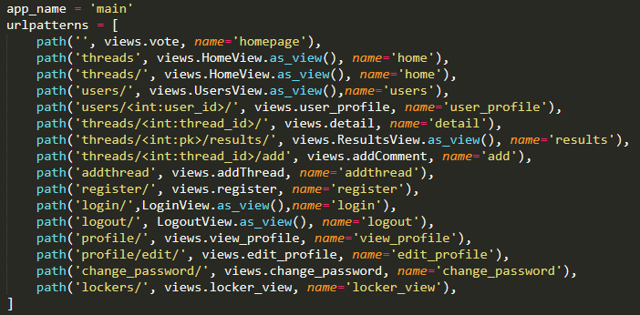


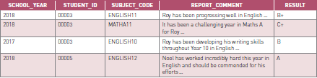
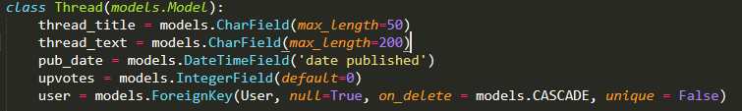
Database Systems- continued 2
Flat file information systems are the most simplistic of information systems as the composition of a flat file format is simply am array of data within one file. As databases, they are simple but perhaps not as effective as other models such as relational databases. With a lack of normalisation, concepts such as data redundancy can occur with the system, leading to concerns with data integrity for developers of these databases. In many cases, database designers prefer to use other database types such as relational databases.
Relational models were devised in the 1970s by E.E Codd where a database is represented as a collection of relations. Data is stored within a table with columns and rows that relates data in relation to their field or primary key.
Hierarchical information systems are one of the earliest forms and can be seen within most operating systems such as within the file storage in Windows. Breadcrumbs and directories can be used to describe this, and this was also used in the Chisholm House Web App, as it is critical in the site map. The characteristic aspect of the hierarchical information system is that a ‘node’ (folder/ directory) can only have a single parent.
Within information systems, there are many different ways data can be constructed inside these systems. Information systems such as hierarchy, flat-file and object-oriented information systems,
Network information systems are an evolution upon the hierarchical version and it is not customary for a node to have single parent. Therefore data can be duplicated in multiple branches of data. However, many consider this to be more complex or too complex to work with.
Keys are a fundamental aspect of any table and database system. They designate the type of cells in a row The structure of a database is the laying of information in the form of columns being the keys. In SQL the keys designate the fields and are elementary in accessing certain types and stores of data. Primary keys are the keys of which the relational database is based on. It can be seen it the case of the example relational database that the primary key is the ‘STUDENT_ID’ key and thus all the information is relative to the increasing student_id.
Object-oriented information systems rules are similar to object-oriented programming such as python. With concepts such as classes, classes as objects, inheritance and properties.
Composite keys are keys that are unique in conjunction with multiple other keys. In can be seen in this example relational database table provided by the QCAA that none of the entries and records cannot particularly be easily identified as unique on any given single cell but only as a conjunction of multiple keys thus ‘STUDENT_ID’ and ‘SUBJECT_CODE’ and the various others can be seen as composite keys.
Flat file information systems is the most simplistic design that involves all the data within one file, data file or spreadsheet. Flat files are good to light-weight data but it is not preferable for higher data complexity.
The relational information system model is the most popular model. It defines the objects and entities within a system and is specialised for identifying the inter-relationships of these entities in the system scope.
Foreign keys are keys that link to other models, tables and records. Usually this links the primary key of another record type or model. It can be seen with this comment example that it links to it’s thread using the ‘thread_id’ being the foreign key in the comment model and the primary key in the thread.

Slide 4

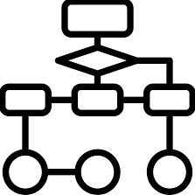

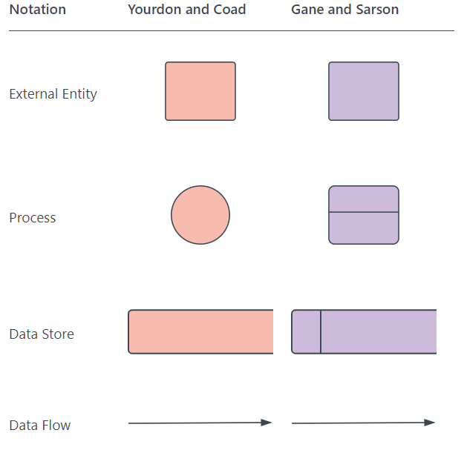

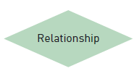
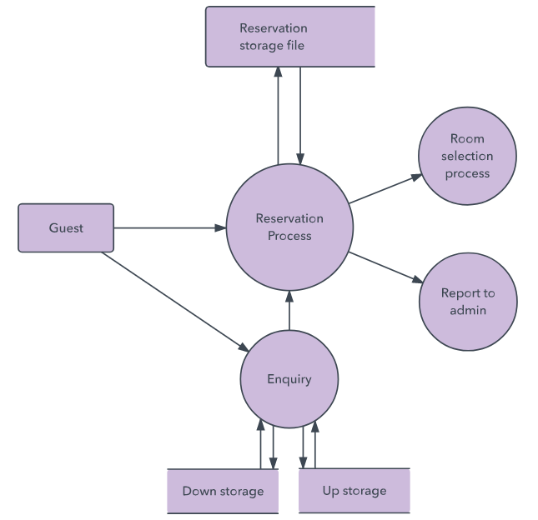

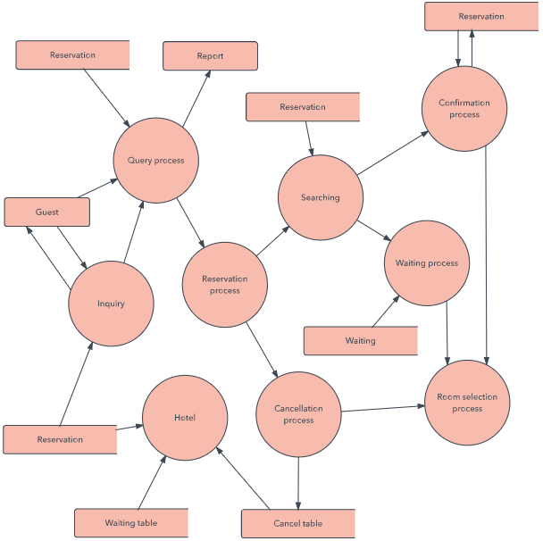
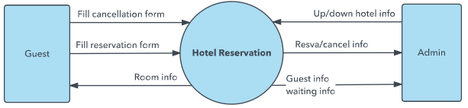


Database DFD
Entity- relationship diagrams is another type of flowchart which describes how ‘entities’ relate to each other within a system. Entities can includes objects, users or concepts. ER diagrams relate to data structure diagrams. Data structure diagrams however focus on the relationships of the elements in the entities rather than the relationships of the entities themselves. ER diagrams use the following shapes for entities, attributes and relationships respectively and the different lines connecting entities can describe how they are related with one-to-one, one-to-many and many-many relationships.
The below diagram is an example of a data-flow diagram within the web app. This can be identified as a Level 1 data flow diagram, as there are sub processes to the thread and comments hat are not highlighted and lacks technicality. It can be seen that there is a one-to-many relationship from the user to the thread and comment entity and a one-to-many relationship between the thread and comment, as each thread must be connected to a user and each comment must be connected to a thread as a comment must be connected to a user. The attributes are listed for the thread and comment being the title and text of each entity and model.
In constructing a database, a good way to analyse and evaluate the processes and flow of data in the data-driven solution can be outlaid in the form of a data-flow-diagram (DFD). Using shapes and defined symbols such as arrows, text, and shapes such as rectangles and circles to show input, output and storage of data, thus being the flow of data.
Upon constructing a data-flow diagram, the components must be understood.
Level 1 Data flow diagrams breaks down the high-level processes of the Level 0 into the main functions within the systems and the high processes subsystems
User
Thread creation
Thread
Lucid chart DFDS
https://www.lucidchart.com/pages/data-flow-diagram#targetText=DFD%20levels%20are%20numbered%200,process%20being%20analyzed%20or%20modeled.
Data-flow diagrams can range in their complexity with the implementation of multiple levels of data flow. “Level 0” is the top level of data flow diagrams and is also called a context diagram. These levels range from 0, 1, 2 and even 3 or beyond at times. Level 0 is the most basic for a data flow diagram and shows a system at a high-level, not going into as much depth into the low-level and technical processes. These diagrams may not be used for specialists in the field of web design but instead a wider audience of professions and people such as stakeholders.
User creates comment
Comment Creation
Thread Title
Comment
Thread Text
Comment Title
Comment Text
Within a data-driven solution there is many times code and algorithms to automate and handle the requests and processes found within a data-driven process/ solution. An IPO chart can be used to outline and develop a given algorithm and the logic within it.
Level 2 goes into further depth than Level 1 as to within Level 1 processes. Level 2 highlights the sub processes outlaid and it can be seen that the text describes more technical processes of the system and it’s functioning.
Use no more than seven processes in a single data flow diagram
Each process must have at least one data flow in and one data flow out
Every data flow must connect to at least one process
Every entity must connect to at least one data process
Data flows in only one direction
Data flow labels describe information and actions
Processes are numbered according to their levels.
Process names are usually verbs
Data flows and data stores are usually nouns.
Inputs | Process | Outputs
Username, First and Last Name, PC, password | Form.save(commit=false) Username=form.clean_data[‘username’] Login(request, user) Form.save() | User logged in with user of fields specified.
The rules of DFDs have been outlined by the QCAA and these rules are from the QCAA Digital Solutions textbook.

Slide 5
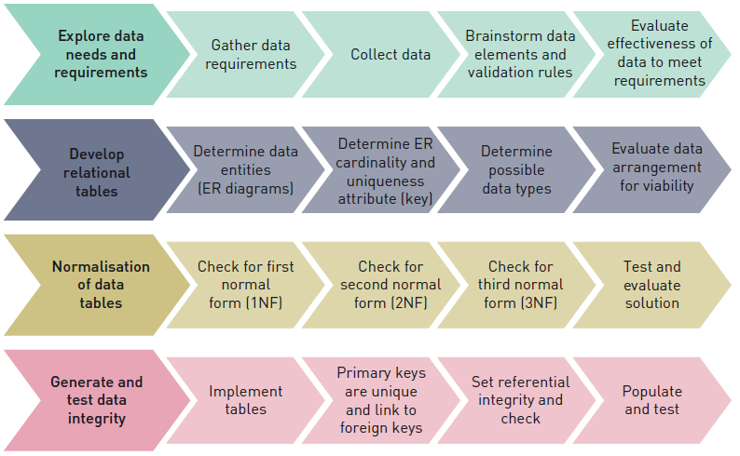
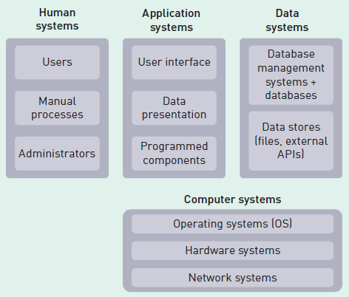




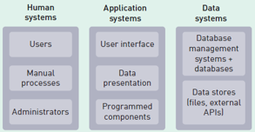
Database DFD- continued
Another resource the QCAA Textbook provides is this visual source of a practical way to developing relational databases for a problem. It can be seen the EDGE process with exploring, developing and generating and evaluating at every step. With such relational database aspects as normalisation, data entities, primary and secondary keys and data integrity.
To develop the different types of data flow diagrams on the various database systems, all the types of systems must be acknowledged and understood. The diagram on the left describes all the subsystems within a given data-driven solution found within the QCAA Digital Solutions textbook.
Human systems are the first of these systems and refer to the input and output to the user. This may also refer to processes outside application or data subsystems. An example of a human system would be the user/ student registration form. The input would be the username, first and last names, PC and other details that can be found in the image below. The output would be the creation of the form and model and then the login of the user. The registration form is obviously not comprised of entirely the human system but instead all of the subsystems. However, the input and output of the registration and the user interface can be described as the human system. A more direct example of a human system is the traditional form where one writes upon lines and boxes such as within a maths test.
Normalisation is the process of converting the visual demonstration of a database to appear simpler and more clear. Using these normalisation techniques makes relational databases more efficient their demonstration and removes potential issues with presentation which can attribute to data integrity issues. There are six normalisation forms with ‘first normal form (NF1)’ to the ‘sixth normal form (NF6)’. In digital solutions, only the three first steps of normalisation are explained.
Computer systems follow after application systems in the textbook. Computing systems refer to the software and hardware of any given systems which directly make up the other subsystems. Within a data-driven solution, knowledge of the components and how the subsystems are connected and depend on the computing system is important. If a game that could only run with at a particular graphics card quality or higher, than it needs to be either adapted or specified for users and what PC or machine they are running this given game on.
One could say that ‘first’ normal form is the form where no normalisation can be seen to have taken effect. This form is called 0NF for zero normal form. It can be seen with this example using the comment model. There are redundancy errors and foreign keys that are yet to be linked.
Application systems are the next subsystem described in the QCAA Digital Solutions textbook. These are the systems that interface between the user (human systems) and the data structure (data system). When the output of the data system being the data structure is interpreted through the application system, the application system then interprets this in a visually easy to understand way. Applications handle input of users and then then the processing of this information to be outputted to the data system and then receiving the interpreted data if called by a user to process and output the data again. An example of an application system at work is if a user wanted to see what users where in what PC of Chisholm. This request would be handled by the application system and then the request is passed to the data system where the data can be processed again by the application system to be demonstrated in a pie chart or a bar graph for example.
ID (Primary Key) | Comment text | User (Foreign Key) | Thread_id (Foreign Key) | User_id (Foreign Key)
2 | Commenting on a thread | Paddy | 3 | 1
3 | I have more to say but can not fit it all in the one comment |  | 3 | 1
4 | Hello | Admin | 3 | 2
5, 6 | Welcome to the thread | Paddy | 3
With this example specifically, there are empty cells that are not accepted for a first normal form table
Application systems may use high-level programming languages and is usually the stage of a data-driven solution that a software developer is most involved/ familiar with.
Data systems relate to the physical data storage and management of data. Within data systems, physical servers and networks will contain the physical bits of data that can be queried or exported. Data can also be stored in direct file storage, but for higher amounts of data it is not a viable option to store such data in a direct file storage or flat file system. In the subsystems, the data subsystems is at the opposite end to the user with the data systems giving data to the requesting application systems.
User input
Processed by application
Request for data, data output
Data processed by application with high-level languages
Front-end presentation of data to user

Slide 6
Database DFD- continued 2
The third normal form is the final form described in the QCAA Digital Solutions syllabus. It should be known that the normal forms can range to NF7 but NF3 is the maximum normalisation form needed. Within this form, almost all of the table should be comprised of primary keys and all those dependent should be separated. It can be seen that the comment text of a given comment is unique only to the one comment, therefore it can separated with regard to the ID, leaving only the primary keys in the table.
The actual ‘first normal form’ is not 0NF but instead 1NF as according to the QCAA Digital Solutions textbook. The first normal form is the first step for checking efficiency and removing such visual presentation errors such as redundancy. Within the first normal form, there can not be over one value per field. It can be seen with this example already compared to the 0NF example. All the cells in the table have been filled and the multiple value fields have been separated into multiple rows.
ID (Primary Key) | Comment text | User (Foreign Key) | Thread_id (Foreign Key) | User_id (Foreign Key)
2 | Commenting on a thread | Paddy | 3 | 1
3 | I have more to say but can not fit it all in the one comment | Paddy | 3 | 1
4 | Hello | Admin | 3 | 2
5 | Welcome to the thread | Paddy | 3 | 1
6 | Welcome to the thread | Paddy | 3 | 1
ID (Primary Key) | Comment text
2 | Commenting on a thread
3 | I have more to say but can not fit it all in the one comment
4 | Hello
5 | Welcome to the thread
6 | Welcome to the thread
ID (Primary Key) | Thread_id (Foreign Key) | User_id (Foreign Key)
2 | 3 | 1
3 | 3 | 1
4 | 3 | 2
5 | 3 | 1
6 | 3 | 1
User_id (Primary Key) | Username
1 | Paddy
2 | Admin
User_id (Primary Key) | Username
1 | Paddy
2 | Admin
The second normal form 2NF translate this normalisation process. Within the form of the second normal form, data must be dependent on the primary key(s) in each record. Keys that are dependent on only one of the primary keys can be separated from the overall table. Within this example, user_id and User are from the same primary key being the user_id, thus this can be seperated
ID (Primary Key) | Comment text | Thread_id (Foreign Key) | User_id (Foreign Key)
2 | Commenting on a thread | 3 | 1
3 | I have more to say but can not fit it all in the one comment | 3 | 1
4 | Hello | 3 | 2
5 | Welcome to the thread | 3 | 1
6 | Welcome to the thread | 3 | 1

Slide 7

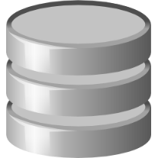

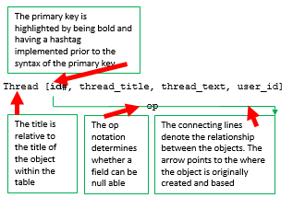
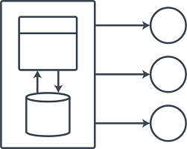
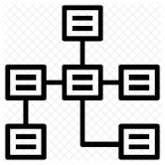
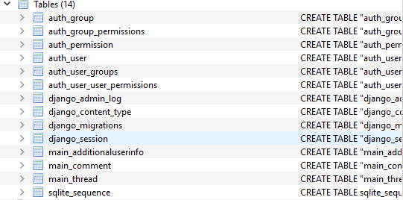
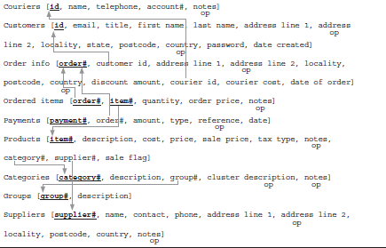
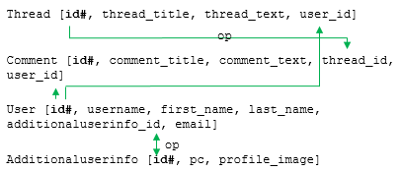
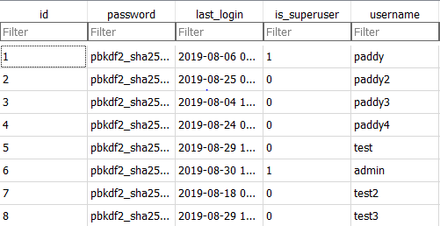



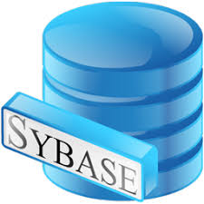

SQL (Standard Query Language)
DB Browser for SQLite is a good resource for accessing and interacting with databases built with SQLite. Within the web app construction using Django, an SQLite database was used and this DB Browser can be of great help when accessing and displaying the data structures within the web app. This structure shows all the models and data structures within the models.
The Chisholm house web app also has many interrelationships that can be described with a relational schema, and understanding the flow of data and relationships between separate entities and structures can greatly attribute to the development of the web app. Within this example, the models in the web app will be outlaid in the relational schema, the models being the User model (provided by django), the Thread and Comment Model and the AdditionalUserInfo model. All these models link to eachother The models and data structures within the system are identified by the following criterion.
Structured Query Language (SQL) is the integral language in data management and relational database design. With SQL, algorithms can be designed for easier access and management of data in a given database. Using the query language in a terminal with such services as MySQL, myPhpAdmin and DbSQLite, data can be accessed and different keys and types may be formatted and obtained.
Relational schemas are described by the QCAA Digital Solutions textbook are ‘the completed diagrammatic representation of the ready-to-be-implemented relational database structure’. These diagrams describe the flow and structure of the relational databases made and focus on the relations of the keys and records within all the given data structures. Within the example provided in the QCAA textbook, the complexity of a system can be seen and thus it can be understood how helpful a relational schema can be in understanding a given system.
This exploration of data in the model can be extended by looking at the individual tables of all the models and data structures.
The two most fundamental control words of SQL can be seen as ‘SELECT’ and ‘FROM’. ‘SELECT’ determines what magnitude and type of data is selected and ‘FROM’ determines from which database this information is being selected or manipulated. Other keywords such as ‘UPDATE’, ‘WHERE’ and ‘REMOVE’ all require ‘FROM’ as they must all relate to a table in a database. All of these keywords are followed by parameters. In the case of ‘FROM’ it Is the database or table name, in the case of ‘WHERE’ it may be a field to be equal to a particular character set. These keywords whilst sometimes seeming to be rudimentary, hold great power in the flow, access and transmission of data.
SQLite is not the only SQL language and service in the world however, there are many different variations due to the significance of SQL to servers. Other SQL languages include
MySQL
PostgreSQL
Sybase
Teradata
Oracle
Whilst not directly dealing with SQL commands, Django uses and handles SQL when creating their tables and models. It can be seen when migrating a model the python code and then the SQL code as to how it is migrated. Django handles this SQL for python developers to code almost all of their back-end in their native language. Other python web app platforms do this also such as Flask and Outsystems.
Queries can be fired using SQL in this browser, and this information can be exported into .csv files.
The SQL language itself can be seen as an array of keywords followed by data or parameters. The words such as SELECT and FROM are fundamental control terms that determine the data transmission and flow.
SELECT
FROM
WHERE

Slide 8
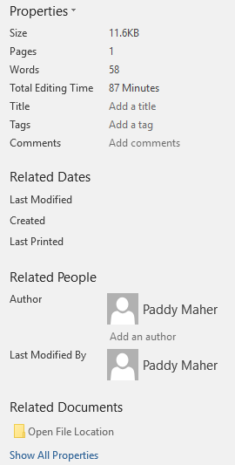

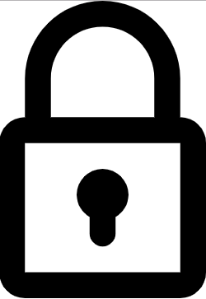




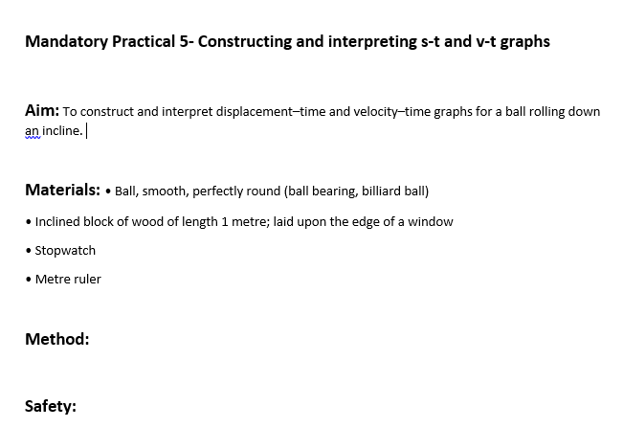


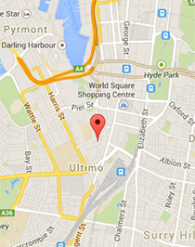

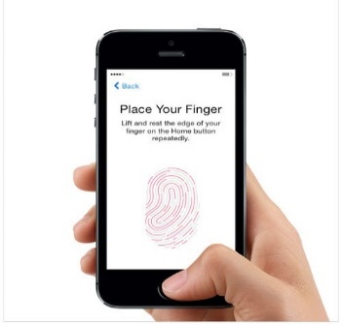
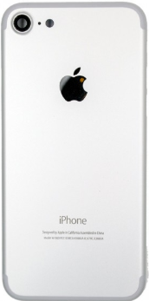
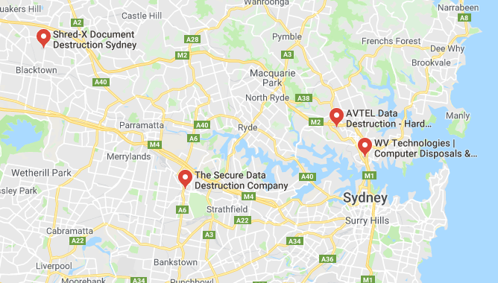

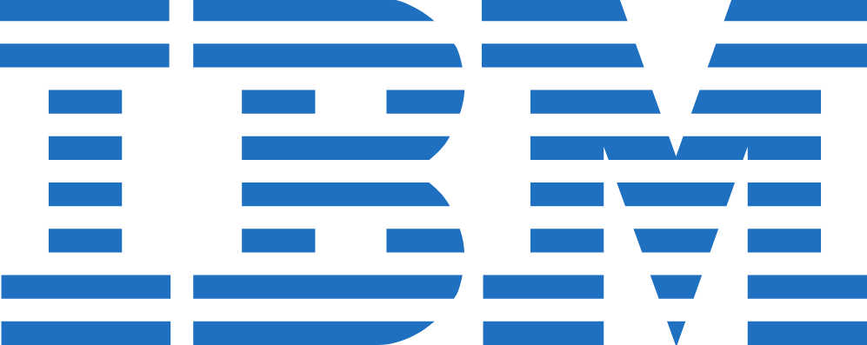


Data evaluation
Metadata is the data that is used to describe data. Metadata is usually formatted as properties within various fields. An example of metadata are the properties of a word document, as seen here the left is the word document (data) and the right shows the properties (metadata)
Among a time where almost all of the civilised world is exposed and connecting with technology, much personal and ultimately valuable information is being stored and transferred on technology and within digital databases. Due to this value in digital databases, the information is prone to security breach, where data can be accessed and sold. Masses of data is being collected and extorted within modern society. The food and diet people employ is collected in digital registers and online shopping, the products one may want to buy online is freely tracked and extorted and much more personal information is being amassed within sites and in companies such as Facebook, Google and Microsoft (OneDrive)
An article by ‘Forbes’ written by Bernard Marr published on the 18th May 2018 describes the magnitude of data created in the world. The article begins with the statement that ‘2.5 quintillion bytes of data is created every day at our current pace’ and ‘that pace is only accelerating with the growth of the Internet of Things (IoT).’ This acceleration is highlighted by the statistic that ’90%’ of the data in the world was generated within the last two years.
The specifics of where this data comes from is also highlighted in the article with such statistics;
3.7 billion humans use the internet’
Google processes more than 40,000 searches every second (3.5 billion searches per day)
Worldwide, 5 billion searches daily
This is without mentioning data from social media and communication which boast equal or greater attention and mass of data. With the increased technologies and medians for data through the IoT (Internet of Things).
The Australian government has it’s own privacy principles including sensitivity of data and how it is extorted.
- the open and transparent management of personal information including having a privacy policy
- an individual having the option of transacting anonymously or using a pseudonym where practicable
- the collection of solicited personal information and receipt of unsolicited personal information including giving notice about collection
- how personal information can be used and disclosed (including overseas)
- maintaining the quality of personal information
- keeping personal information secure
- right for individuals to access and correct their personal information
Data Servers are the storage of the data across the world. Within the data servers, all types of data is stored within the terabytes of information from 0000000 to 1111111.IBM was the first company to use data servers and ever since with the vast amount of data being mining and extorted today, companies such as IBM and Oracle have much business. With the sheer computing power of data servers, cooling and research on alternative methods of computation is constantly being implemented and worked upon for data servers. Qarnot Computing is a company based in France that works on making climate friendly data servers, such as one implemented in Paris, as pictured above.v
With the masses of data within the world, shredding and disposal is relevant for whenever companies need new technologies, to save space or just simply that data is not wanted. Data can be stored in various ways and methods however many of the old technologies are unreadable; such as hard drives and tapes. Therefore, shredding and destruction of these tapes and hard drives is necessary. There are many companies that provide this service; it can be seen that there are four of these companies within the inner city of Sydney.
Data Disposal is a necessary step when any company deploys new technologies, ‘Evernex’ is a larger company that deals with this in a climate friendly way, with destruction of hardware storage such as tapes and hard drives to software storage.
Even within the famous iPhone of which 2.2 billion have been sold, there are many examples of data mining within the base model of the iPhone. With the camera feature, the fingerprint passcode and Google Maps on the Phone, the iPhone could already know one’s face, location and fingerprint; all of which are examples of personal information.
Data holds much value in being used by governments and major corporations to shape their business and political structures and operations. For most companies and governments there are specialised strands of data analysis such as ‘Data Science’ with professions suiting that specialisation. Within Data Science, all types of governments and companies use maths and science to analyse data typically minded to create the most effective business plans and structures.

Slide 9

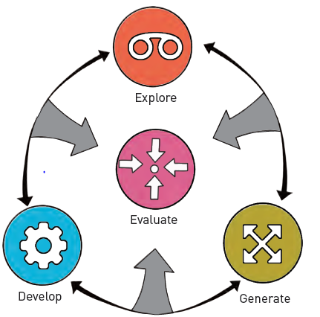


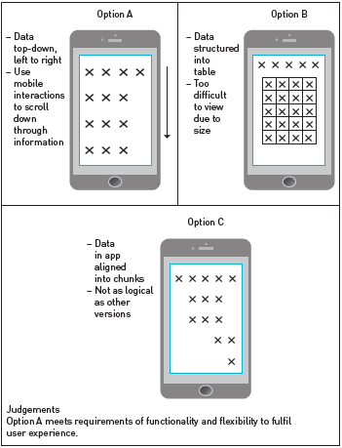
Data evaluation- continued
Criteria | Yes/ No | Comment
Customer Data | Yes | Web survey
Product Data | Yes | Samples only
Open data | No | Not current
Weather sensor | No | Too local
Weather API | Yes | Nationwide
User experience | Yes | Tips page
Mapping data | Yes | Google Maps
Web server | Yes | Free online service
Crowdsourcing | No | Data quality
Responsive layout | Yes | Mobile
Data driven solutions are digital solutions in which the problem of focus is data/ information. It is important to recall that the problem solving process is not linear. The evaluation stage is not necessarily at the end, as it may have been in the past, or even within the EDGE acronym (Explore, design, generate, evaluation).
Evaluation can be called upon in exploring where data can be analysed to see if it’s an effective process or aspect within a solution. The table on the left is Figure 2.4.8 from QCAA Digital Solutions textbook on page 189. This table shows how various aspects and processes can be evaluated in a table.
Evaluation is not limited to being used within the ‘explore’ phase however. Evaluation can also be used within the two others phases within the EDGE process, being ‘develop’ and ‘generate’. As can be seen with another textbook example, there are three options made in the development process for this example with laying data out on a tablet webpage. These options can be evaluated to determine which is most effective for displaying the data; just being data evaluation.
De-identifying data is used to remove information within a data that can describe or identify an individual. It enhances the privacy of a user and keeps an appropriate digital footprint as to not leak information that can tracked to an individual. De-identifying data can also mean implementing the necessary safeguards and control elements for preventing exposure of personal information and data.
De-identifying data is almost compulsory via the Australian Privacy Principles (APPs). Within the Privacy Act instated in 1988, APPs determines how personal information is collected, used, discloses and stored. APP 6 places limits on the sharing and releasing of personal data. If information can be properly de-identified, it can be freely shared in ways permitted by the Privacy Act.
Making subjects anonymous to the public is a good example od de-identifying potentially personal information.

